Slide 1

Entity Framework Core - Introduction
The ORM Concept
SoftUni Team
Technical Trainers
Software University
https://about.softuni.bg/

Slide 2
Table of Contents
Entity Framework Core
EF Core Components
Reading Data
CRUD Operations
EF Core Configuration
Fluent API
Database Migrations
2

Slide 3
Have a Question?
sli.do
#csharp-db

Slide 4

Entity Framework Core
Overview and Features

Slide 5
Entity Framework Core: Overview
The standard ORM framework for .NET and .NET Core
Provides LINQ-based data queries and CRUD operations
Automatic change tracking of in-memory objects
Works with many relational databases (with different providers)
Open source with independent release cycle
5

Slide 6
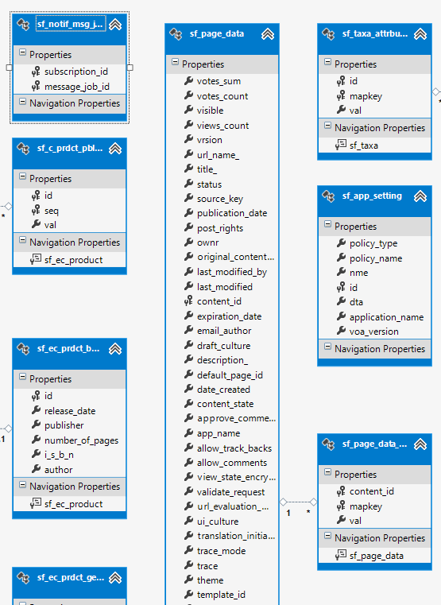
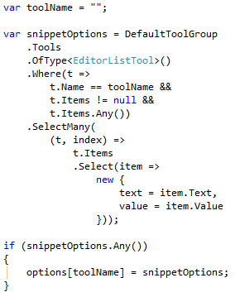
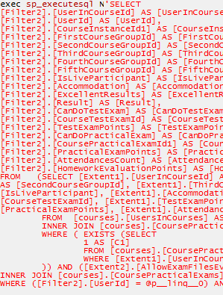
EF Core: Basic Workflow (1)
Define the data model (Code First or Scaffold from DB)
Write & execute query over IQueryable
EF generates & executes an SQL query in the DB

Slide 7
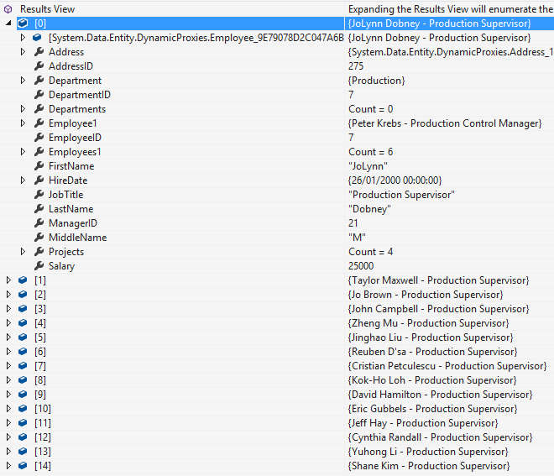
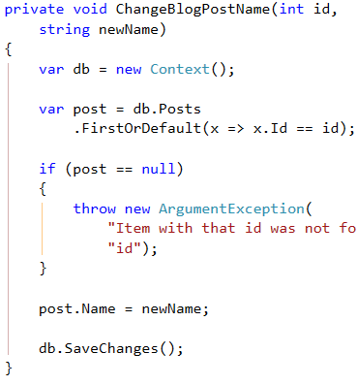
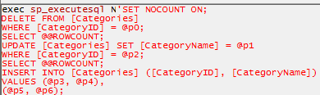
EF Core: Basic Workflow (2)
EF transforms the query results into .NET objects
Modify data with C# code and call "Save Changes()"
Entity Framework generates & executes SQL command to modify the DB

Slide 8
Entity Framework Core: Setup
To add EF Core support to a project in Visual Studio
Install it from NuGet using Visual Studio or dotnet CLI
EF Core is modular – any data providers must be installed too
To use the Entity Framework Core CLI tools
dotnet add package Microsoft.EntityFrameworkCore
Microsoft.EntityFrameworkCore.SqlServer
dotnet tool install --global dotnet-ef
dotnet add package Microsoft.EntityFrameworkCore.Design

Slide 9
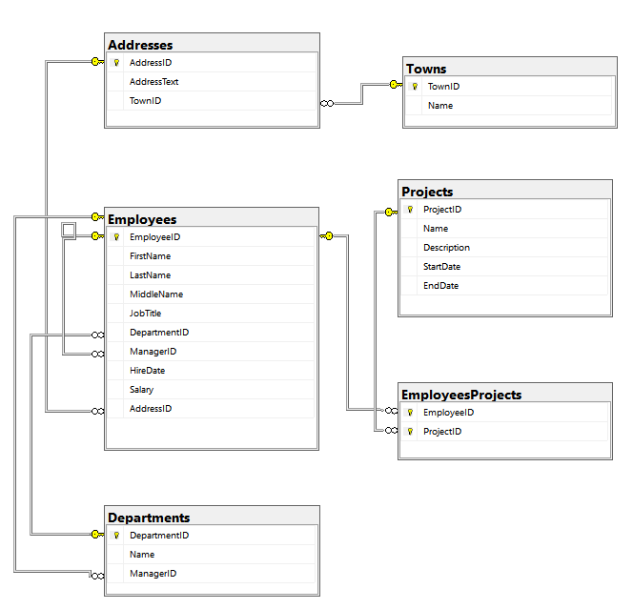
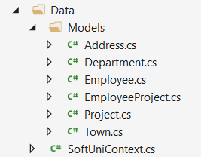
Database First Model
Database First model models the entity classes after the database

Slide 10
Database First Model: Setup
Scaffolding DbContext from DB with EF Core CLI Tools
To update with the latest database changes, use the -f flag
To use attributes for configuring the model use the -d flag
Scaffolding requires the following NuGet packages installed
Microsoft.EntityFrameworkCore.SqlServer
Microsoft.EntityFrameworkCore.Design
dotnet ef dbcontext scaffold "Server=…;Database=…;Integrated Security=true" Microsoft.EntityFrameworkCore.SqlServer -o Models
dotnet ef dbcontext scaffold "…" Microsoft… -o Models -f -d

Slide 11
EF Core Components
DbContext
Post
User
Overview of System Objects

Slide 12
Domain Classes (Models) (1)
Bunch of normal C# classes (POCO)
May contain navigation properties for table relationships
Recommended to be in a separate class library
public class PostAnswer
{
public int Id { get; set; }
public string Content { get; set; }
public int PostId { get; set; }
public Post Post { get; set; }
}
Primary key
Foreign key
Navigation property

Slide 13
Domain Classes (Models) (2)
Another example of a domain class (model)
public class Post
{
public int Id { get; set; }
public string Content { get; set; }
public int AuthorId { get; set; }
public User Author { get; set; }
public IList<PostAnswers> Replies { get; set; }
}
Navigation property
One-to-Many relation

Slide 14
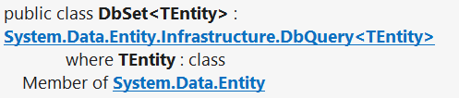
DbSet Type
Maps a collection of entities from a table
Set operations: Add, Attach, Remove, Find
DbContext contains multiple DbSet<T> properties
public DbSet<Post> Posts { get; set; }

Slide 15
The DbContext Class
Usually named after the database e.g. BlogDbContext, ForumDbContext
Inherits from DbContext
Manages model classes using DbSet<T> type
Implements identity tracking, change tracking
Provides API for CRUD operations and LINQ-based data access
Recommended to be in a separate class library
Don't forget to reference the EF Core library + any providers
Use several DbContext if you have too much models

Slide 16
Defining DbContext Class - Example
EF Reference
using Microsoft.EntityFrameworkCore;
using CodeFirst.Data.Models;
public class ForumDbContext : DbContext
{
public DbSet<Category> Categories { get; set; }
public DbSet<Post> Posts { get; set; }
public DbSet<PostAnswer> PostAnswers { get; set; }
public DbSet<User> Users { get; set; }
}
Models Namespace

Slide 17

Reading Data
Querying the DB Using Entity Framework

Slide 18
The DbContext Class
DbContext provides:
CRUD Operations
A way to access entities
Methods for creating new entities (Add() method)
Ability to manipulate database data by modifying objects
Easily navigate through table relations
Executing LINQ queries as native SQL queries
Managing database creation/deletion/migration

Slide 19
Using DbContext Class
First create instance of the DbContext:
In the constructor you can pass a database connection string
DbContext properties:
Database - EnsureCreated/Deleted methods, DB Connection
ChangeTracker - Holds info about the automatic change tracker
All entity classes (tables) are listed as properties
e.g. DbSet<Employee> Employees { get; set; }
var context = new SoftUniDbContext();

Slide 20
Reading Data with LINQ Query
Executing LINQ-to-SQL query over EF entity:
Employees property in the DbContext:
using (var context = new SoftUniEntities())
{
var employees = context.Employees
.Where(e => e.JobTitle == "Design Engineer")
.ToArray();
}
EF translates this to an SQL query
public partial class SoftUniEntities : DbContext
{
public DbSet<Employee> Employees { get; set; }
public DbSet<Project> Projects { get; set; }
public DbSet<Department> Departments { get; set; }
}

Slide 21
Reading Data with LINQ Query
We can also use extension methods for constructing the query
Find element by ID
using (var context = new SoftUniEntities())
{
var employees = context.Employees
.Where(c => c.JobTitle == "Design Engineering")
.Select(c => c.FirstName)
.ToList();
}
ToList() materializes the query
using (var context = new SoftUniEntities())
{
var project = context.Projects.Find(2);
Console.WriteLine(project.Name);
}

Slide 22
LINQ: Simple Operations (1)
Where()
Searches by given condition
First()/Last() / FirstOrDefault()/LastOrDefault()
Gets the first/last element which matches the condition
Throws InvalidOperationException without OrDefault
Select()
Projects (conversion) collection to another type
OrderBy() / ThenBy() / OrderByDescending()
Orders a collection

Slide 23
LINQ: Simple Operations (2)
Any()
Checks if any element matches a condition
All()
Checks if all elements match a condition
Distinct()
Returns only unique elements
Skip() / Take()
Skips or takes X number of elements

Slide 24
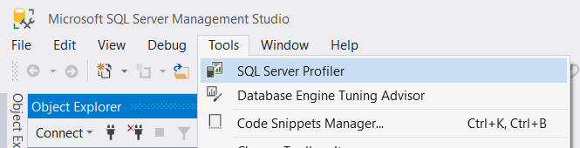
Logging the Native SQL Queries
Queries sent to SQL Server can be monitored with the SQL Server Profiler
Included with the SQL Server installation
Queries can be get using the built-in ToQueryString() method
db.Courses.Where(x => x.Title == "EF Core").ToQueryString()

Slide 25
CRUD Operations
CRUD
With Entity Framework

Slide 26
Creating New Data
To create a new database row use the method Add(…) of the corresponding DbSet:
Create a new Project object
var project = new Project()
{
Name = "Judge System",
StartDate = new DateTime(2015, 4, 15),
};
context.Projects.Add(project);
context.SaveChanges();
Add the object to the DbSet
Execute SQL statements

Slide 27
Cascading Inserts
We can also add cascading entities to the database:
The Project will be added when the Employee entity (employee) is inserted to the database
Employee employee = new Employee();
employee.FirstName = "John";
employee.LastName = "Doe";
employee.Projects.Add(new Project { Name = "SoftUni Conf"} );
softUniEntities.Employees.Add(employee);
softUniEntities.SaveChanges();

Slide 28
Updating Existing Data
DbContext allows modifying entity properties and persisting them in the database
Just load an entity, modify it and call SaveChanges()
The DbContext automatically tracks all changes made on its entity objects
SELECT the first order
Employees employee =
softUniEntities.Employees.First();
employees.FirstName = "Alex";
context.SaveChanges();
Execute an SQL UPDATE

Slide 29
Deleting Existing Data
Delete is done by Remove() on the specified entity collection
SaveChanges() method performs the delete action in the database
Employees employee =
softUniEntities.Employees.First();
softUniEntities.Employees.Remove(employee);
softUniEntities.SaveChanges();
Mark the entity for deleting at the next save
Execute the SQL DELETE command

Slide 30


EF Core Configuration
NuGet Packages, Configuration

Slide 31
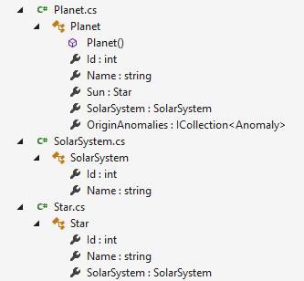
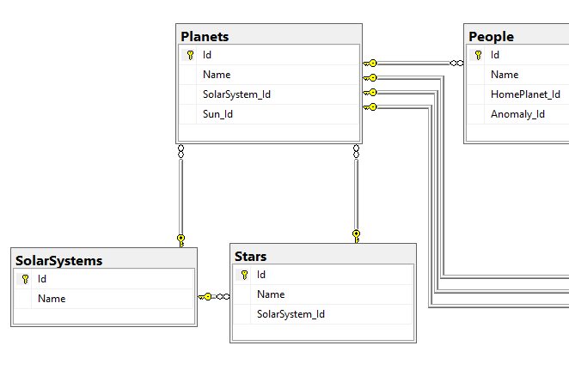
What is the Code First Model?
Code First means to write the .NET classes and let EF Core create the database from the mappings
31

Slide 32
Why Use Code First?
Write code without having to define mappings in XML or create database tables
Define objects in C# format
Enables database persistence with no configuration
Changes to code can be reflected (migrated) in the schema
Data Annotations or Fluent API describe properties
Key, Required, MinLength, etc.

Slide 33
Code First with EF Core: Setup
To add EF Core support to a project in Visual Studio:
Install it from Package Manager Console
Or using .NET Core CLI
EF Core is modular – any data providers must be installed too
Install-Package Microsoft.EntityFrameworkCore
dotnet add package Microsoft.EntityFrameworkCore
Microsoft.EntityFrameworkCore.SqlServer
33

Slide 34
How to Connect to SQL Server?
One way to connect is to create a Configuration class with your connection string:
Then add the connection string in the OnConfiguring method in the DbContext class
public static class Configuration
{
public const string ConnectionString = "Server=.;Database=…;";
}
protected override void OnConfiguring(DbContextOptionsBuilder builder)
{
if (!builder.IsConfigured)
builder.UseSqlServer(Configuration.ConnectionString);
}

Slide 35
Fluent API
The OnModelCreating method let us use the Fluent API to describe our table relations to EF Core
protected override void OnModelCreating(ModelBuilder builder)
{
builder.Entity<Category>()
.HasMany(c => c.Posts)
.WithOne(p => p.Category);
builder.Entity<Post>()
.HasMany(p => p.Replies)
.WithOne(r => r.Post);
builder.Entity<User>()
.HasMany(u => u.Posts)
.WithOne(p => p.Author);
}

Slide 36
Database Connection Workflow
Database Exists?
Yes
Use Database
No
Create Database

Slide 37
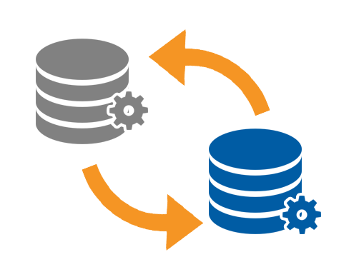
Database Migrations

Slide 38
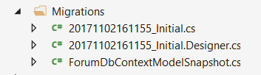
What Are Database Migrations?
Updating database schema without losing data
Adding/dropping tables, columns, etc.
Migrations in EF Core keep their history
Entity Classes, DB Context versions are all preserved
Automatically generated
38

Slide 39
Migrations in EF Core
To use migrations in EF Core, we use the dotnet ef migrations add command from the EF CLI Tools
To undo a migration, we use migrations remove
Commit changes to the database
dotnet ef migrations add {MigrationName}
dotnet ef migrations remove {MigrationName}
dotnet ef database update
db.Database.Migrate()

Slide 40

Summary
…
…
…
ORM frameworks maps database schema to objects in a programming language
Entity Framework Core is the standard .NET ORM
LINQ can be used to query the DB through the DB context

Slide 41
Questions?
Notes:
41

Slide 42












SoftUni Diamond Partners

Slide 43


Educational Partners

Slide 44
Trainings @ Software University (SoftUni)
Software University – High-Quality Education, Profession and Job for Software Developers
softuni.bg, about.softuni.bg
Software University Foundation
softuni.foundation
Software University @ Facebook
facebook.com/SoftwareUniversity
Software University Forums
forum.softuni.bg
44
Notes:
44

Slide 45

License
This course (slides, examples, demos, exercises, homework, documents, videos and other assets) is copyrighted content
Unauthorized copy, reproduction or use is illegal
© SoftUni – https://about.softuni.bg
© Software University – https://softuni.bg
Notes:
45

